Slide 1

Forecasting, and Analyze digital currency
Name: Meshal Fahad Almubarak

Slide 2
Introduction
Organizing for the financial analysis process.
price of the digital currency will predict whether it will fall or rise in the future.
trader in the cryptocurrency market.
Building a model that uses the previous database
Why?
Goal:
Who?
How?

Slide 3
Steps before Model
Understanding the Problem.
Data Extraction.
Data Cleaning.
Data Analysis.

Slide 4
characteristics/features for data
Close
Open
Low
Weighted Price.
High
Volume Currency
Volume BTC

Slide 5
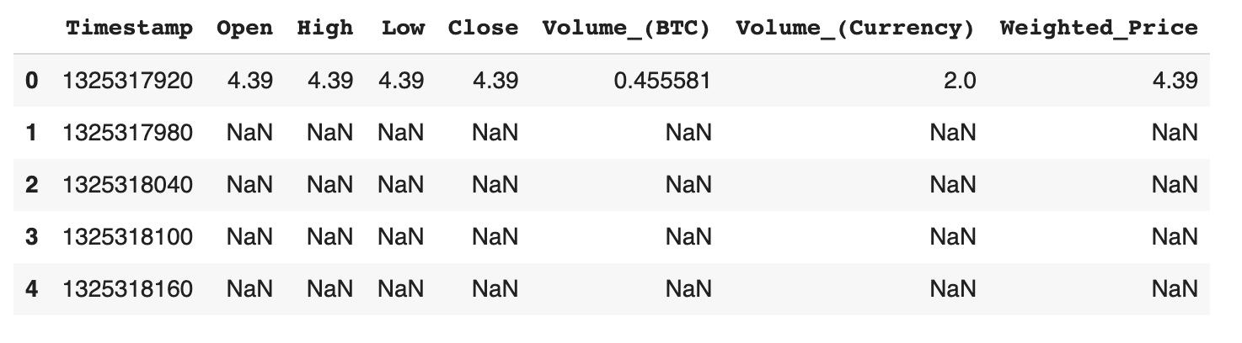
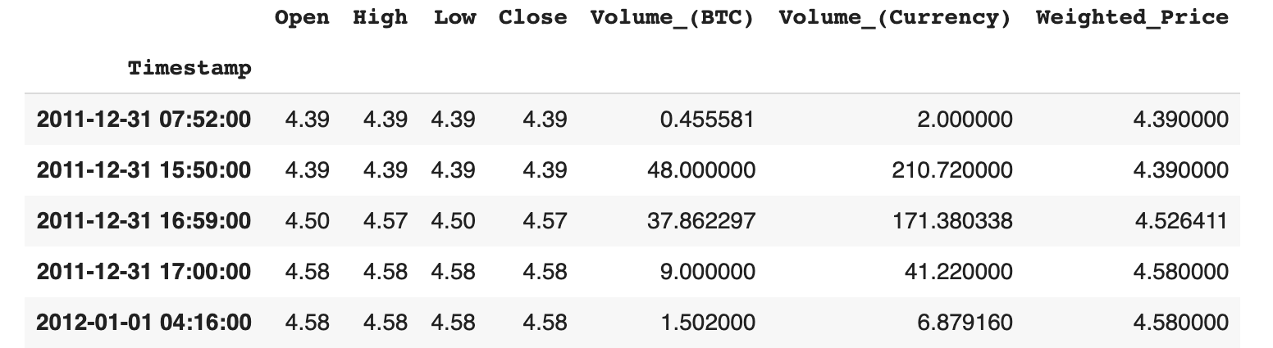
Data
4,857,377 rows
3,613,769 rows

Slide 6
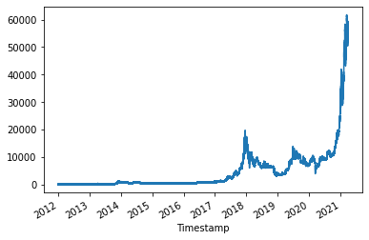
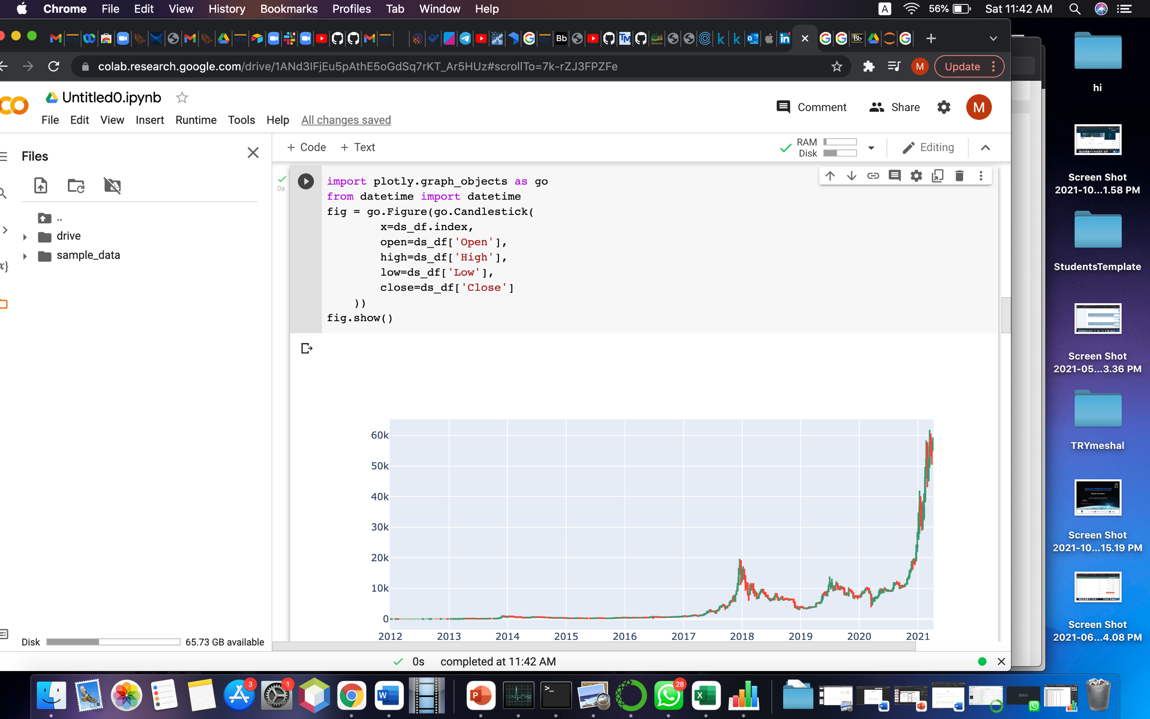
Data

Slide 7
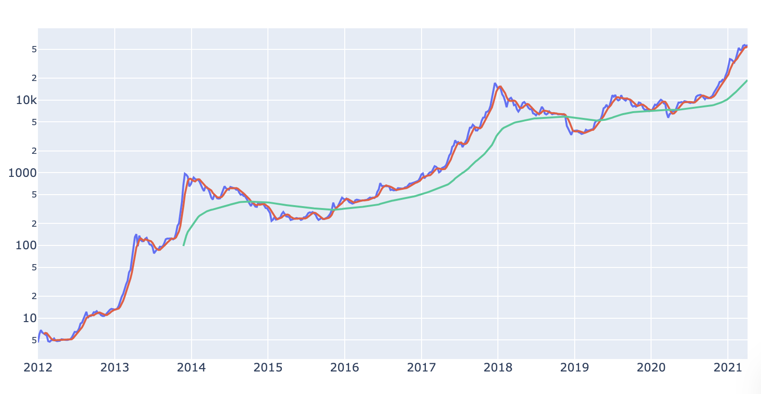
Data

Slide 8
Steps on Model
Feature Selection.
Incorporating Machine Learning Algorithms.
Train&Testing the Models.
Check Results and Deploying the Model.

Slide 9
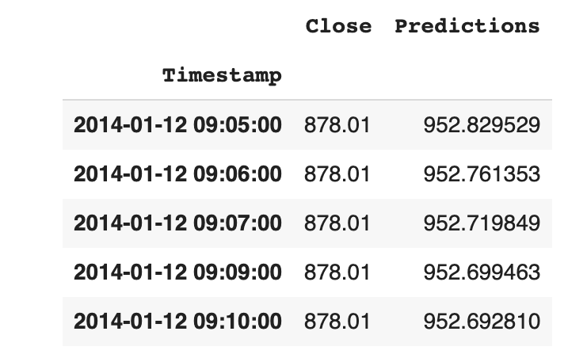
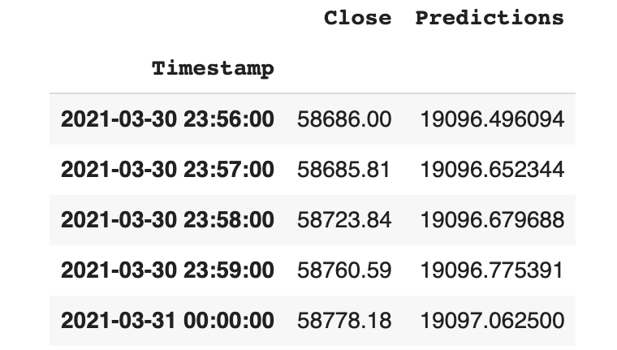
Data after Training

Slide 10
prediction equation
Last 120 days
Find the result
Range of train

Slide 11
Project Development in Future
Train all data
Connect API
Try with a new arithmetic, and model

Slide 12
Thank You!

